Slide 1
Nestlé – Good Food, Good Life
Palm oil sourcing strategycoffee%20and%20energy%20beverage%20category,%2DT.
MGMT 569: Ethical and Sustainable Supply Chain Management
Faculty Advisor – Dr. Gokce Esenduran

Slide 2




Team Introduction
Danielle Valdez MSGSCM - 2024
Saiteja Singaru MSGSCM - 2024
Tejashree Shendge MSGSCM - 2024
Neha Priya MSGSCM - 2024

Slide 3




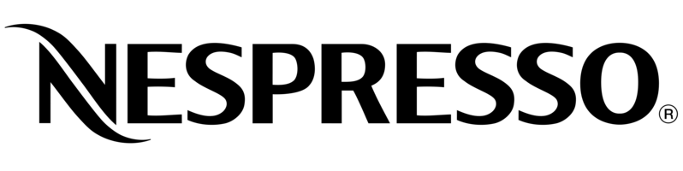
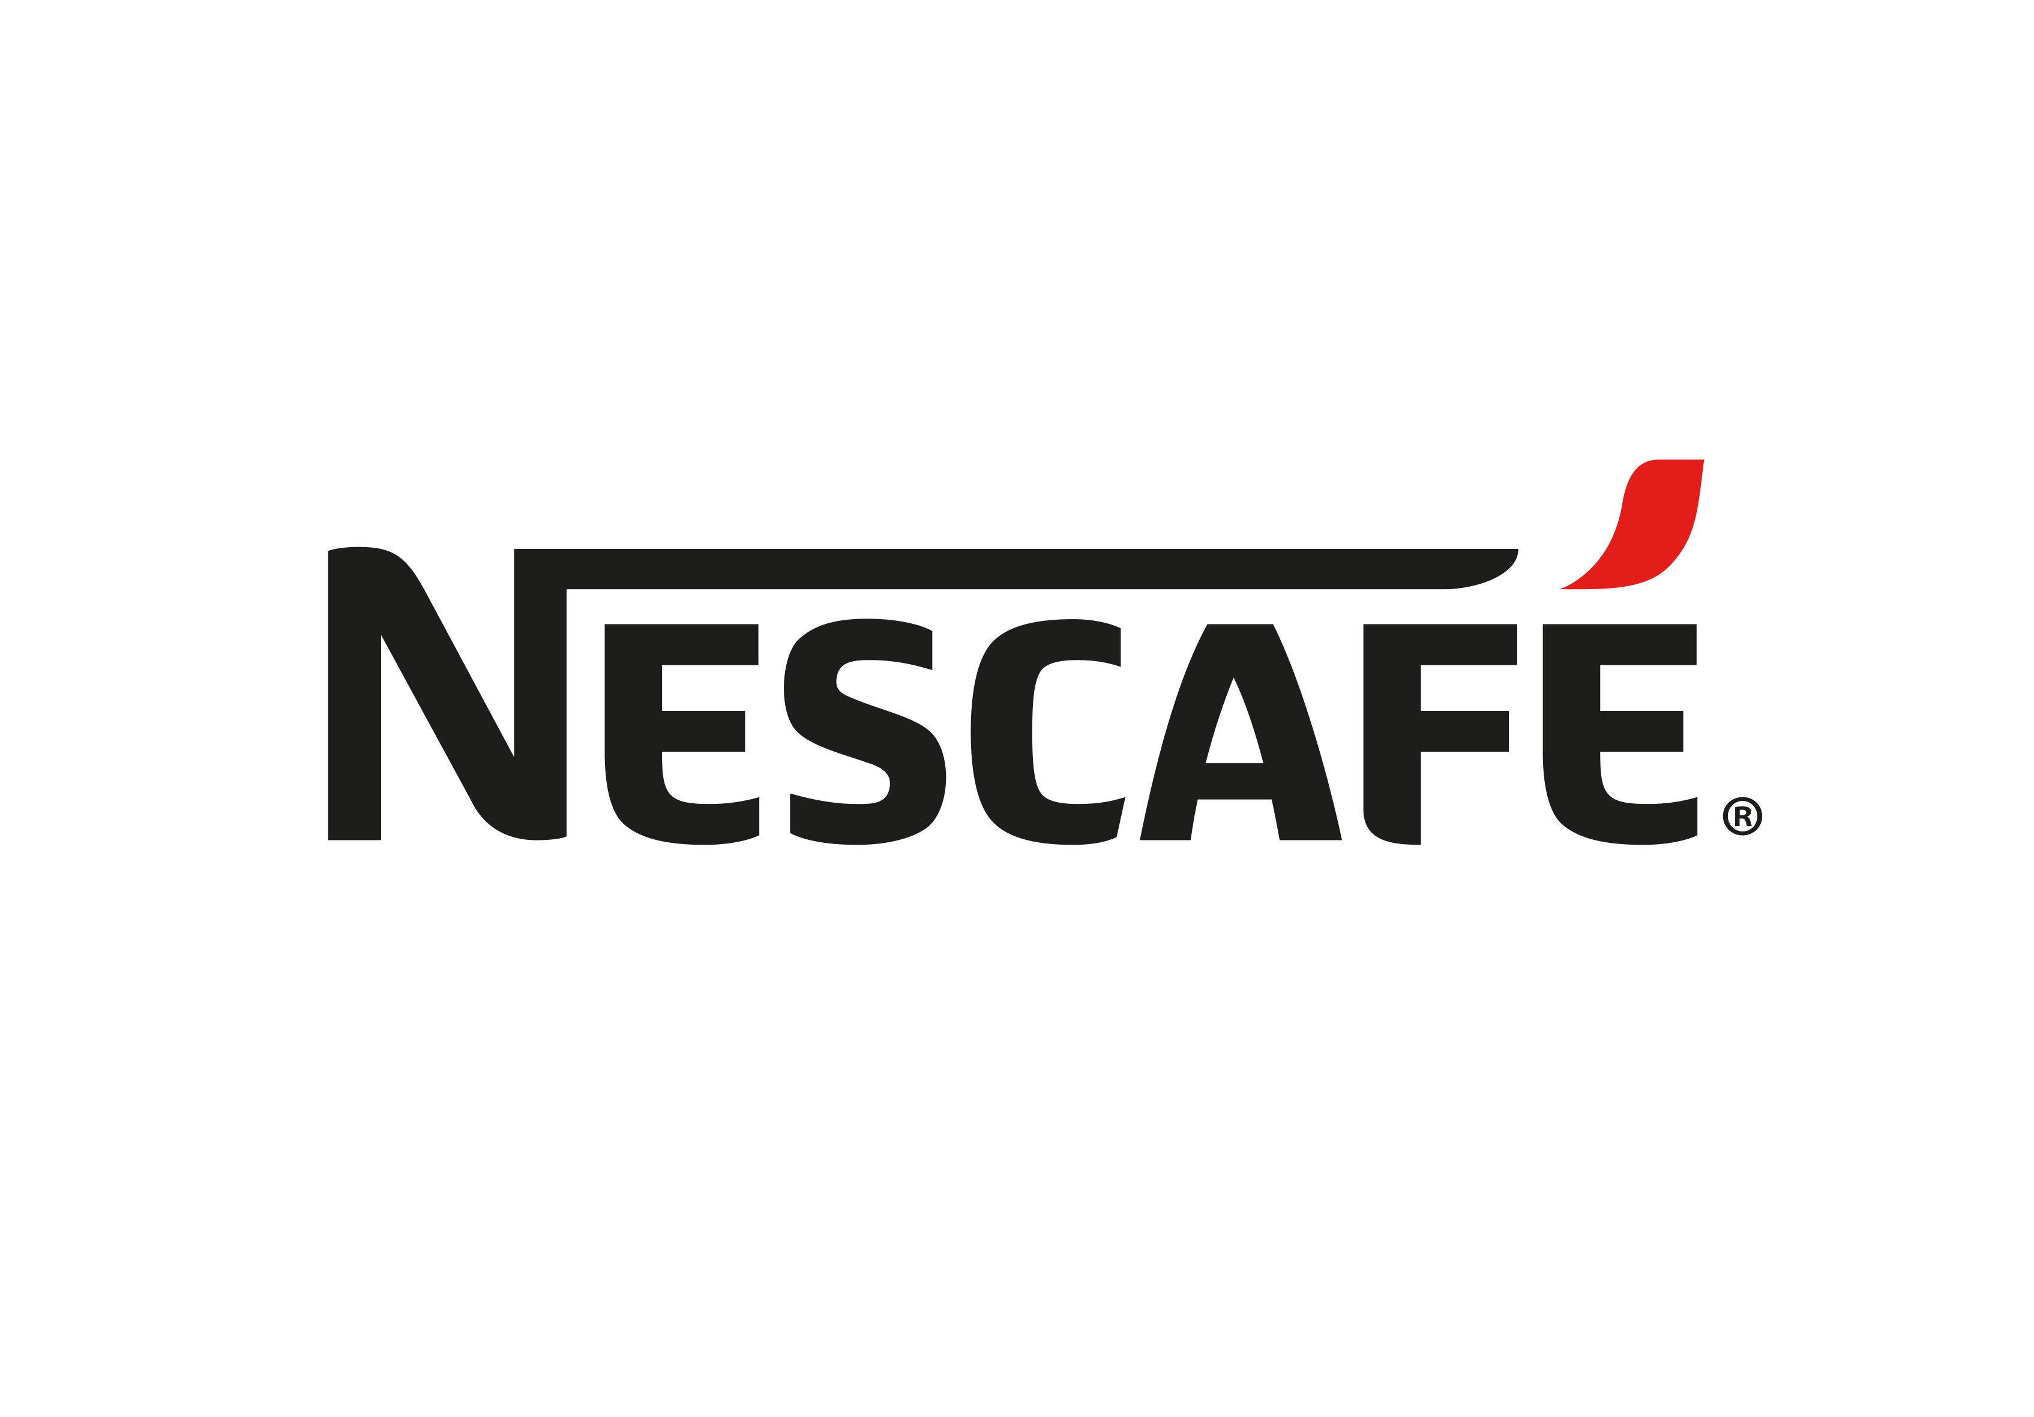
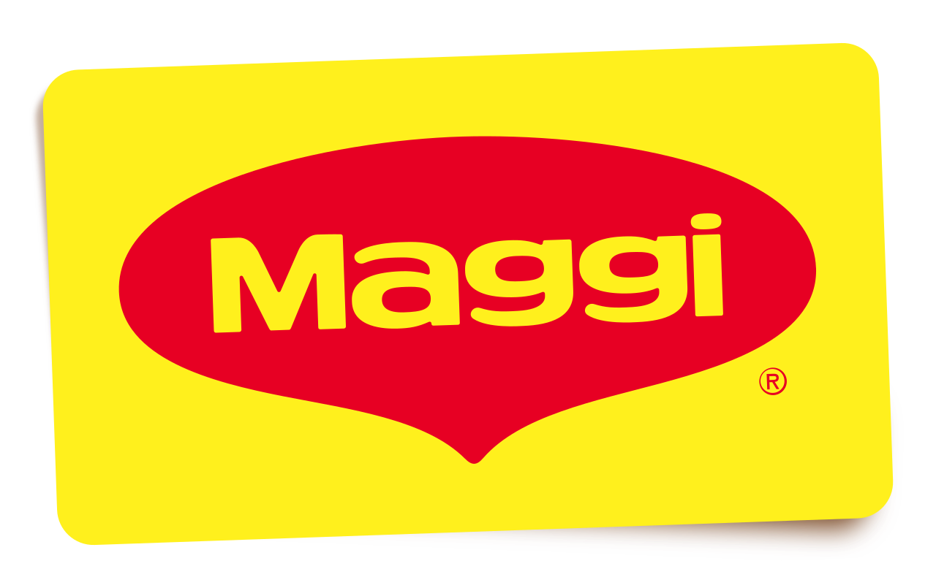
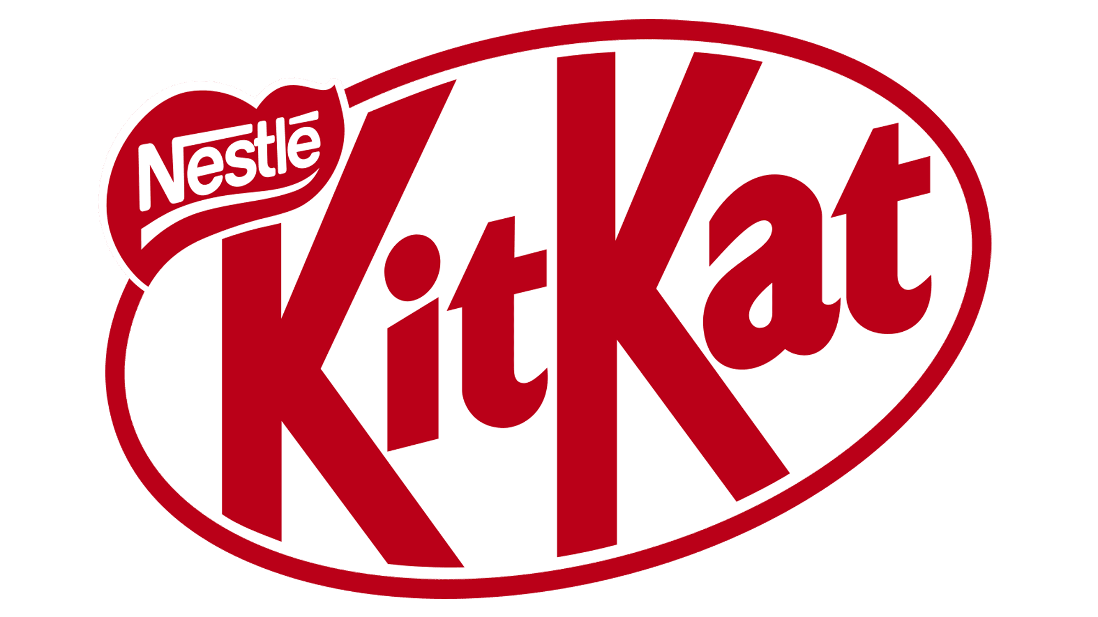


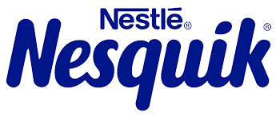
Background¹
Origin – 1860 from 2 Swiss Enterprises and expanded in US & Europe in next 2 decades
$ 1.1B Sales from 29 Brands
Product Lines – Food & Snacks, bottled water, Coffee & tea, confectionery, Dairy products etc..
447 factories in 189 countries
339k Employees
L’Oreal --> One of the main shareholders

Slide 4
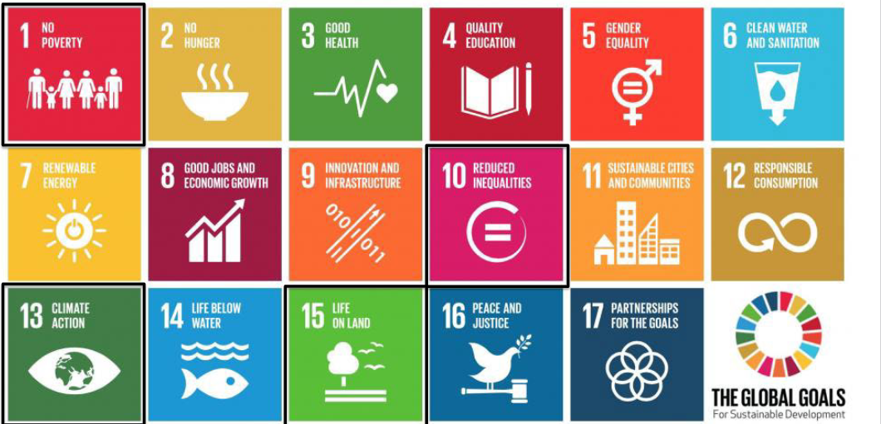
Scope of our project
We will be focusing on the 15th United Nations sustainability goal Life on Land², analyzing how we can protect, restore, and promote sustainable use of terrestrial ecosystems by strategic sourcing of PALM OIL.

Slide 5

Nestlé’s sustainability goals

Slide 6

Sustainability Commitments^{3, 15}
Reduce Greenhouse gas (GHG) emissions by 20% by 2025 and 50% by 2030, on the road to net zero by 2050 at the latest
Achieve and maintain 100% assessed deforestation-free primary supply chains
Source 20% of key ingredients through regenerative agriculture
Reduce water use in our factories by 6 million m³
100% of key ingredients volumes to be produced sustainably by 2030
Design above 95% of our plastic packaging for recycling and continue to work toward 100% being recyclable or reusable
Help 10 million young people around the world have access to economic opportunities

Slide 7



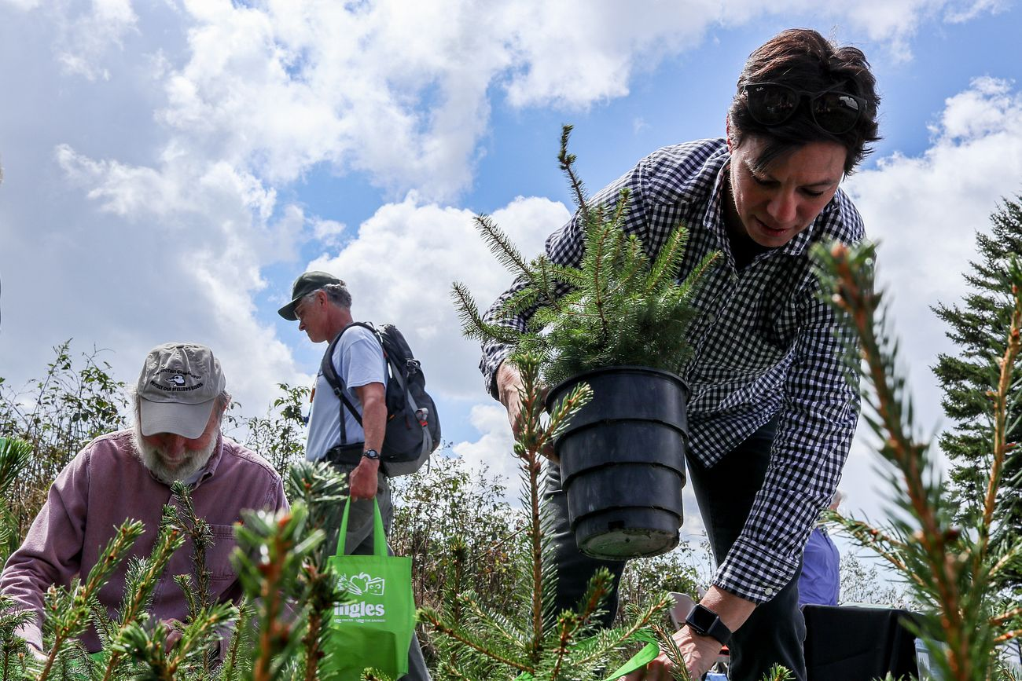
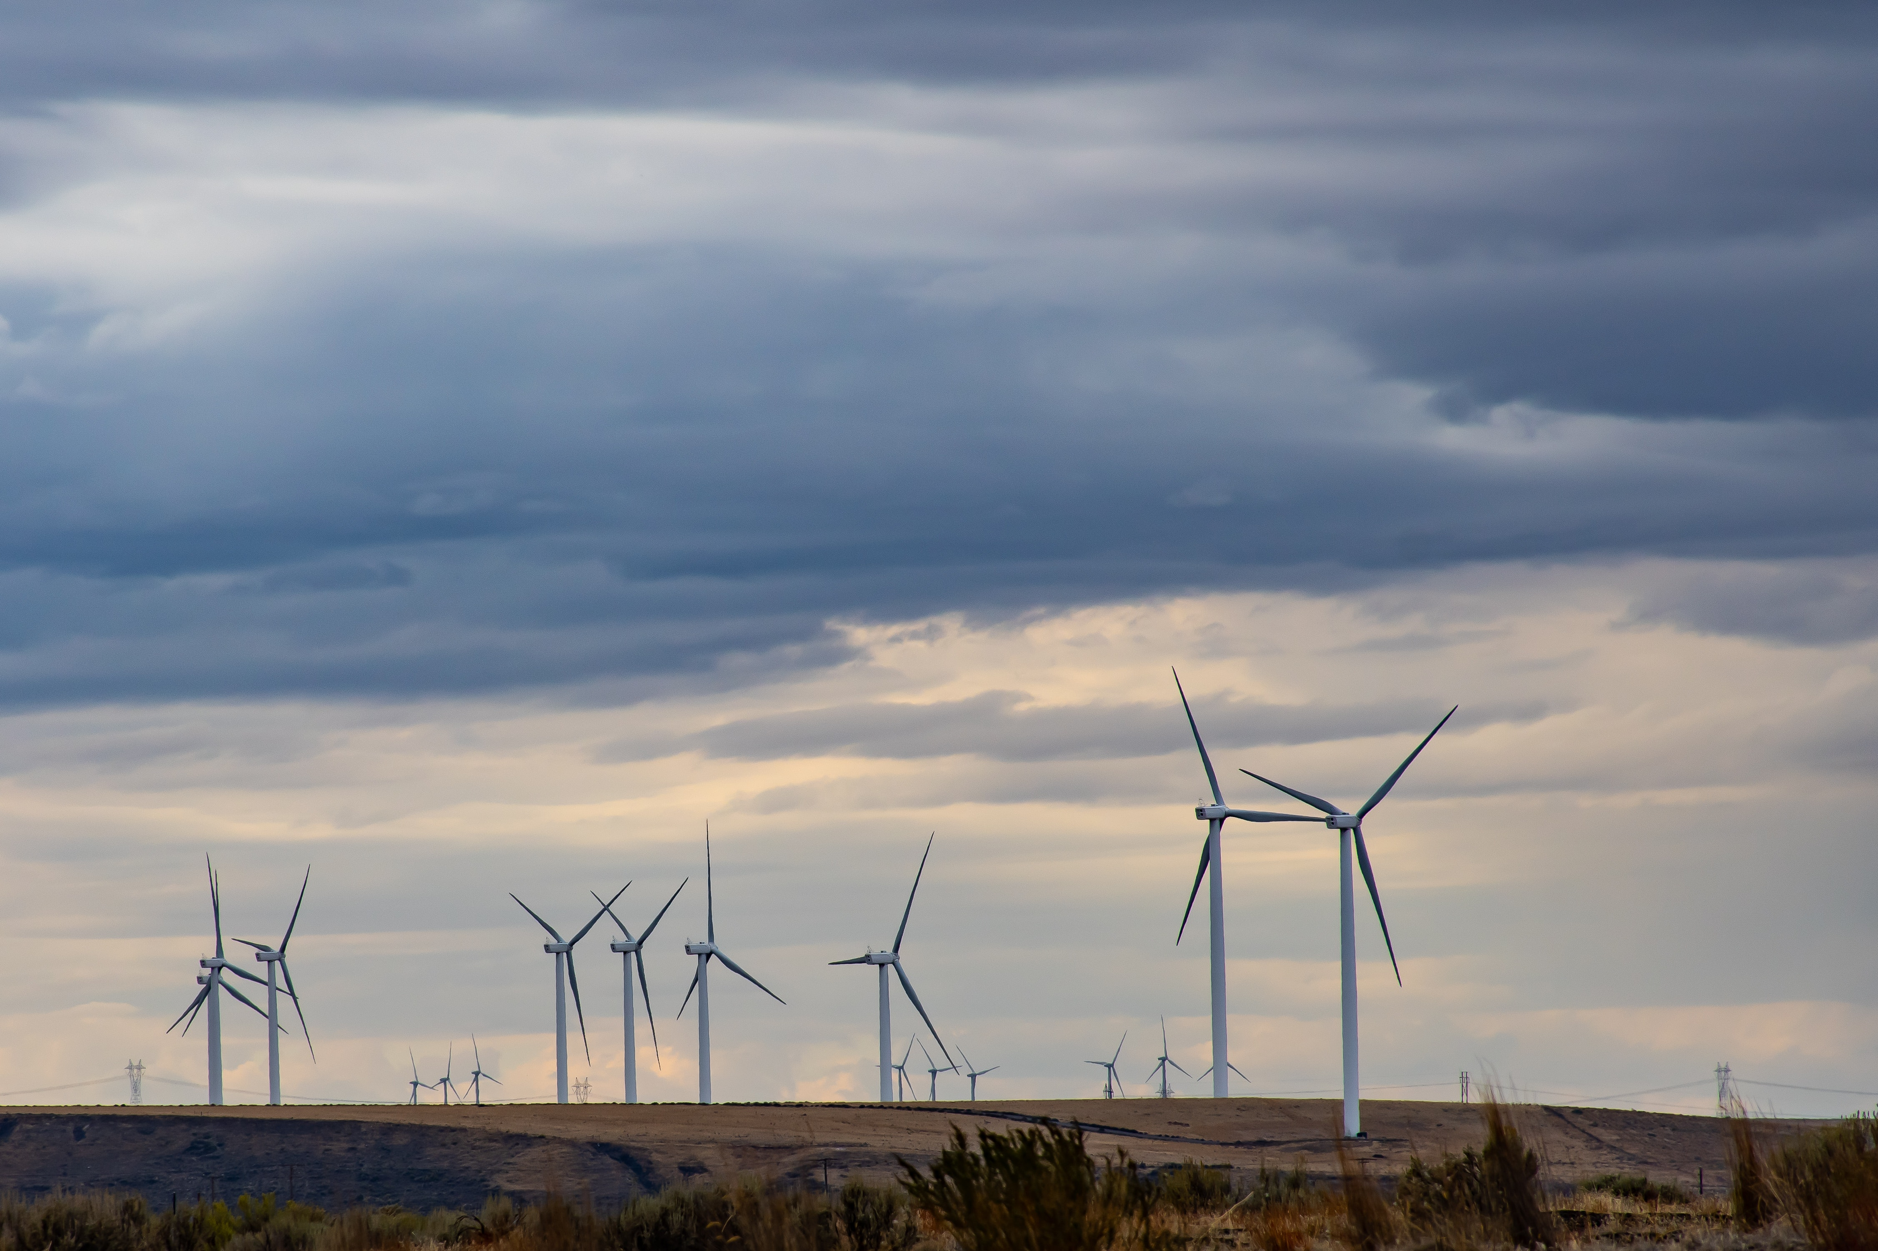
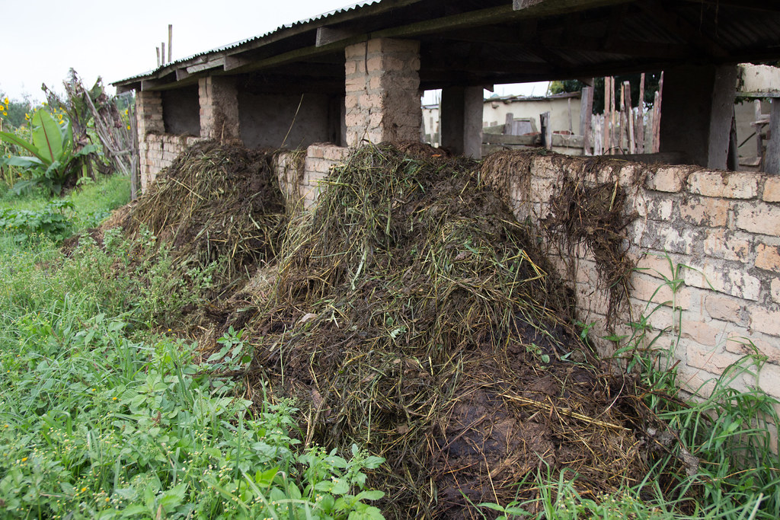
Initiatives to meet its sustainability goals^{3, 4}
Gerber: Expanding on commitment to the next generation
Nescafe: Decades of partnership
Kitkat: Innovating to transform community impact
Manure management
Global Reforestation program
Renewable electricity

Slide 8

Palm oil – Why is it important?

Slide 9
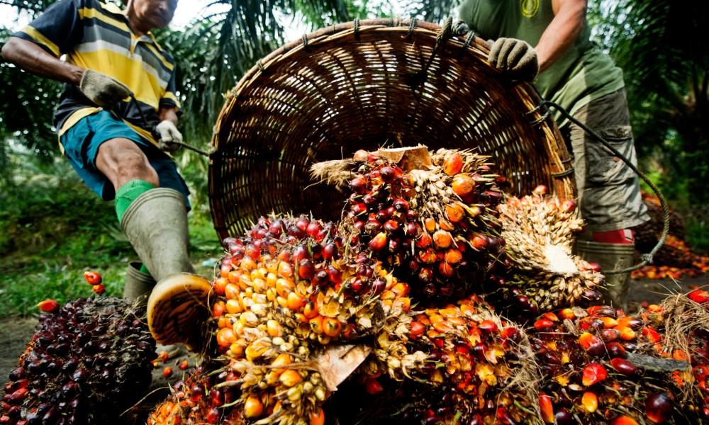
Characteristics
Overview⁵
Natural vegetable oil crop grown mainly in Malaysia and Indonesia (85%)
Characteristics
Resistant to spoilage
Versatile
Semi-solid at room temperature
Stable at high temperatures
Odorless + colorless
Used commonly in food and cosmetic products (e.g. chocolate, soap, peanut butter)

Slide 10
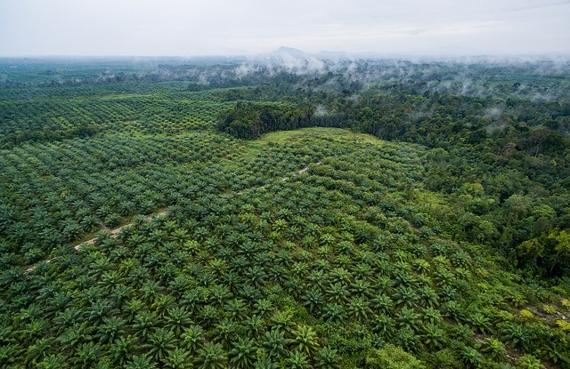
Challenges in palm oil generation
There are some notable challenges with palm oil generation⁶
Deforestation to create plantations
Habitat loss for endangered species
Air pollution generated from burning to clear land
Peat soil conversion — loss of carbon sinks
Effluent polluting freshwater sources
Human rights issues⁹

Slide 11

Nestlé’s current palm oil sourcing approach
Monitoring + Transparency
Nestlé prioritizes traceability within its supply chain
Palm Oil Transparency Dashboard⁷
Published online and accessible
Helps Nestlé understand deforestation patterns in its supply chain
Verifying supplier’s no-deforestation claims
Identifying opportunities for conservation

Slide 12
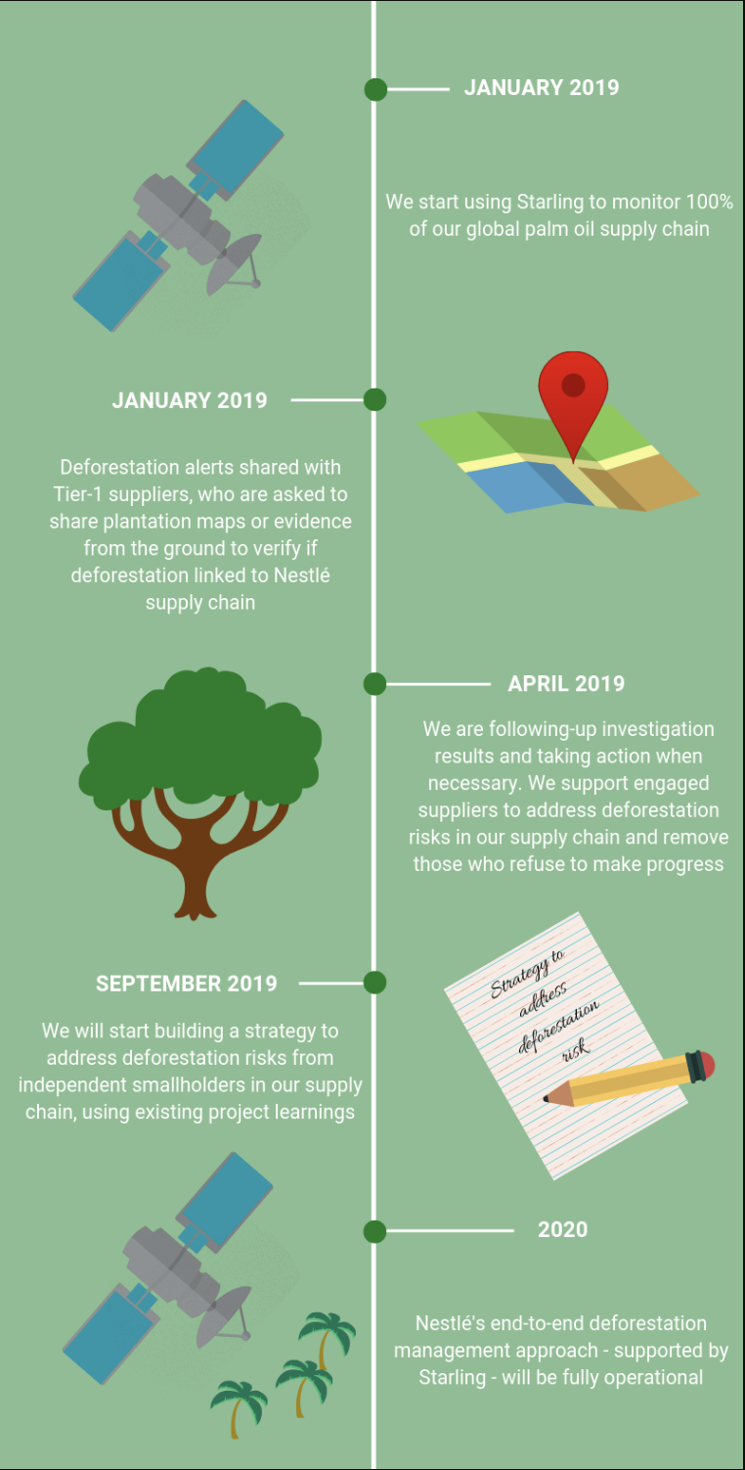
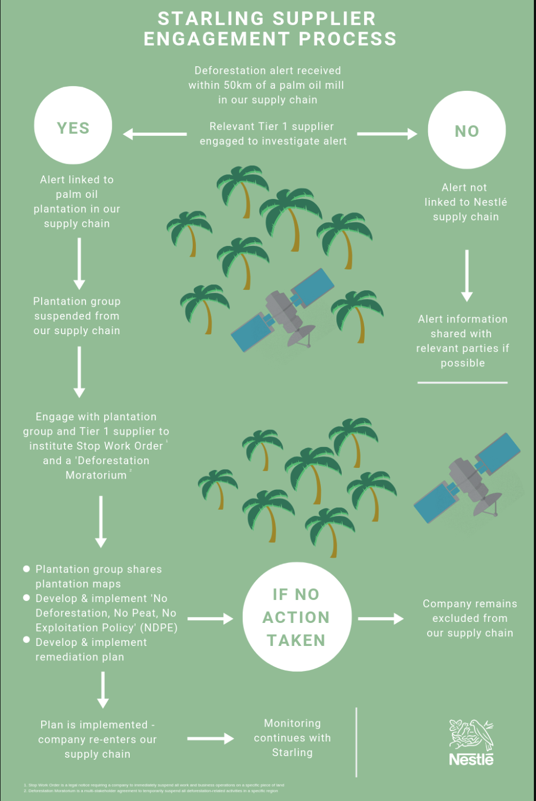
Current Efforts and Approach (contd.)
Starling Journey⁸
Engaging Suppliers

Slide 13
Sourcing Challenges

Slide 14
PALM OIL SOURCING PROBLEMS
Human Rights Violations
Supply Chain abuses by Nestle's big suppliers like ADM, Wilmar, Olam and Cargill In Indonesia, Malaysia, Honduras, Peru etc.
Workers are pressured to work for extended periods and meet a daily target.
One worker was quoted as saying: ““I get the premi [bonus] from the loose fruit that’s why my kids help me. I wouldn’t be able to meet the target … otherwise. … The foreman sees my children helping me. The foreman says it is good that my child is helping me.”⁹
Evidence of use of Paraquat.
The investigators found one instance of a worker that was splashed in the face by the chemical, leading to severe injuries. “I can’t see through the eye. I get headaches in part of my head, when I do, my eye feels really swollen. I still get a bit dizzy”.⁹

Slide 15
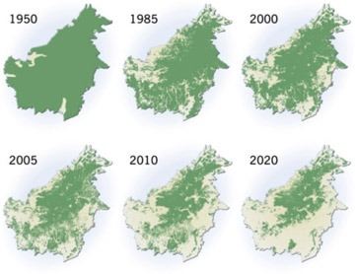
“13 Years Later Palm Oil is Still a Haunting Reality…”
“IN 2010, NESTLÉ PROMISED TO CREATE 100% DEFORESTATION-FREE SUPPLY CHAINS WITHIN TEN YEARS.”¹⁰
Nestlé Group alone used 455,000 tons of palm oil in 2019 alone.
1,735 palm oil suppliers from 24 countries.
24,000 hectares of rainforest cleared within the concessions.¹¹
Starling satellite - Nestle received 388,047 alerts – mainly in Indonesia and Malaysia – which corresponds to 1,063 alerts/day.
Total forest loss detected is approximately 472,513 hectares in 2019.¹¹
“Nestlé continues to engage in large-scale greenwashing with unverified claims of 95.6% deforestation-free supply chains.”¹²
Extent of Deforestation in Borneo 1950-2005, Projection to 2020. The island of Borneo is split between Malaysia, Indonesia, and Brunei.

Slide 16
RSPO Certification
What does it mean to be “Certified Sustainable”?
Goal of 100% of palm oil produced sustainably by 2023.
Nestlé uses the Roundtable on Sustainable Palm Oil (RSPO)¹³ certification
Serious and long-running failures in the RSPO’s sustainability verification process have been identified by EIA and Grassroots in reports.²⁰
Studies have come out that show RSPO certified plantations occupy land that was once habitats for endangered animals
~75% of RSPO land is in areas that have been deforested and/or home to endangered species in the last 30 years¹⁴
“RSPO does not take into account the recent past of plantations it certifies”¹⁴

Slide 17
Recommendations

Slide 18

Recommendations
Unilever's approach to building inclusive, deforestation–free palm oil supply chains is something that can be easily replicated by Nestlé.
Nestlé must adopt Unilever’s direct sourcing strategy¹⁹ by sourcing directly from producers on the ground.
Direct sourcing involves working with primary producers and mills, who are among the most important stewards of the land, to source palm oil directly.
By supporting independent mills and smallholder farmers, Unilever enables them to access the resources needed to adopt sustainable practices.
Nestlé is actively pursuing a strategy that aims to eliminate deforestation, and by embracing Unilever's direct sourcing approach, they can efficiently expand and achieve their sustainability objectives within the specified timeframe.
Also, to eliminate issues related to labor abuses, Nestle should educate and create more awareness through various campaigns.
Adopt competitor’s strategy

Slide 19
Recommendations
Palm Oil Alternatives?
Direct substitution — Swapping palm oil for coconut oil, canola oil etc¹⁶
Marginally more sustainable — potentially (with some large issues)
Still presents land use issues + can lead to deforestation
Canola crops grow slower, coconut crops are tropical only etc
Could require 4—10x more land¹⁶
Concerns that switching to another kind of oil will just encourage deforestation to grow that crop instead

Slide 20
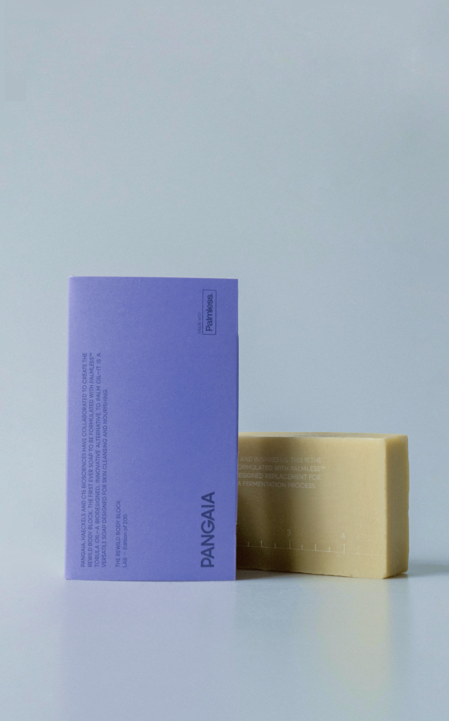
Recommendations
Palm Oil Alternatives?
Startups such as C16 Biosciences’ Palmless products
MIT startup uses yeast to produce lab-grown palm oil replacements for consumer products¹⁷
Their first collaboration is a bar soap
Product roadmap includes expanding to food
Received $3.5M Bill & Melinda Gates Foundation funding for this expansion!

Slide 21

Recommendations
C16 Biosciences’ Palmless products¹⁸
Benefits
Complete reduction in deforestation from palm oil
Fast process
6 days from start to finish vs ~7 years to plant + harvest trees
Potential for land use reduction + cost reductions
Optimized process projected to be cheaper, fermentation equipment takes up less space than a forest

Slide 22
Recommendations
C16 Biosciences’ Palmless products¹⁸
Issues
Regulations don’t allow Palmless oils to be used in food (yet!)
Currently pursuing FDA Generally Recognised As Safe status
Startups don’t have the scale required to completely replace palm oil
At present the process is costly
Would require Nestlé to invest significant time + money
Could be hidden climate impacts for the process
More research needed!

Slide 23

Sources

Slide 24
Sources
1. “At a Glance.” Nestlé Global, www.nestle.com/about/overview. Accessed 18 Feb. 2024.
2. “Sustainable Development Goals.” UNDP, www.undp.org/sustainable-development-goals/life-on-land?gad_source=1&gclid=CjwKCAiA8sauBhB3EiwAruTRJkxiqLYnrtS28opMRVkyifRDPsiB93a4TS0OInhgpMRxmTKi7jLOcxoClkcQAvD_BwE. Accessed 18 Feb. 2024.
3. Accelerate, Transform, Regenerate: - Nestlé’s Net Roadmap, www.nestle.com/sites/default/files/2020-12/nestle-net-zero-roadmap-en.pdf. Accessed 18 Feb. 2024.
4. Gandon, Aude. “3 Nestlé Brands Taking Action On Sustainability.” Nestlé Global, www.nestle.com/stories/brands-actions-impact-sustainability. Accessed 18 Feb. 2024.
5. “8 Things to Know about Palm Oil.” WWF, www.wwf.org.uk/updates/8-things-know-about-palm-oil. Accessed 18 Feb. 2024.
6. “What Is Palm Oil? Facts about the Palm Oil Industry.” WWF, World Wildlife Fund, www.worldwildlife.org/industries/palm-oil. Accessed 18 Feb. 2024.

Slide 25
Sources
7. “Our Palm Oil Transparency Dashboard.” Nestlé Global, www.nestle.com/sustainability/sustainable-sourcing/palm-oil/satellite-monitoring. Accessed 18 Feb. 2024.
8. “Remote Sensing, Forest Cover Change Monitoring: Starling.” Remote Sensing, Forest Cover Change Monitoring | Starling, intelligence.airbus.com/industries/forest-and-environment/starling/. Accessed 18 Feb. 2024.
9. Webb, Jonathan. “Amnesty International Slams Colgate, Nestlé and Unilever for Palm Oil Supply Chain Abuses.” Forbes, Forbes Magazine, 30 Nov. 2016, www.forbes.com/sites/jwebb/2016/11/30/amnesty-international-slams-colgate-nestle-and-unilever-for-palm-oil-supply-chain-abuses/.
10. Nestlé No Deforestation Commitment - Nestle, www.nestle.com/sites/default/files/2020-05/nestle-deforestation-update.pdf. Accessed 18 Feb. 2024.
11. Chandrasekhar, Anand. “Nestlé Identified over 1,000 Cases of Deforestation per Day in Palm Oil Areas.” Swiss Info, www.swissinfo.ch, 28 Jan. 2024, www.swissinfo.ch/eng/business/nestl%C3%A9-identified-over-1-000-cases-of-deforestation-per-day-in-palm-oil-areas/46035408.

Slide 26
Sources
12. Workman, Timothy. “Big Brands Show Little Sign of Progress in Our 2023 ‘keep Forests Standing’ Scorecard - the Understory.” Rainforest Action Network, 15 Nov. 2023, www.ran.org/the-understory/big-brands-show-little-sign-of-progress-2023/.
13. “A Global Partnership to Make Palm Oil Sustainable.” Roundtable on Sustainable Palm Oil (RSPO), 5 Feb. 2024, rspo.org/.
14. “‘Meaningless Certification’: Study Makes the Case against ‘sustainable’ Palm Oil.” Mongabay Environmental News, 13 Aug. 2020, news.mongabay.com/2020/08/palm-oil-certification-sustainable-rspo-deforestation-habitat-study/.
15. Creating Shared Value and Sustainability Report 2022, www.nestle.com/sites/default/files/2023-03/creating-shared-value-sustainability-report-2022-en.pdf. Accessed 18 Feb. 2024.
16. Enerva, Kaycee. “Sustainable Alternatives to Palm Oil: Do They Exist?” Viable Earth, 16 Aug. 2022, viable.earth/understanding/sustainable-alternatives-to-palm-oil-do-they-exist/.
17. “Technology: C16 Biosciences.” Technology | C16 Biosciences, www.c16bio.com/technology. Accessed 18 Feb. 2024.

Slide 27
Sources
18. PalmlessTM Collaborations - Powered by Nature, for Nature, www.gopalmless.com/collaborations. Accessed 18 Feb. 2024.
19. “Unilever Is Direct Sourcing Sustainable Palm Oil.” Unilever, Unilever PLC, 27 Dec. 2023, www.unilever.com/news/news-search/2023/building-inclusive-deforestation-free-palm-oil-supply-chains/#:~:text=What%20is%20direct%20sourcing%3F,of%20the%20sustainable%20supply%20chain
20."Environmental Investigation Agency." 18 February 2021, https://eia-international.org/news/consumers-are-still-unable-to-trust-sustainable-palm-oil-watchdogs-seal-of-approval/#:~:text=%E2%80%9CThe%20RSPO's%20badge%20of%20approval,in%20reality%20they%20are%20not.&text=%E2%80%9CDespite%20various%20actions%20over%20the,RSPO%20will%20fix%20the%20problems.

Slide 28

Thank You!!
Questions?

